Slide 1
CSE 465 Lecture 9-1
Deep learning projects

Slide 2
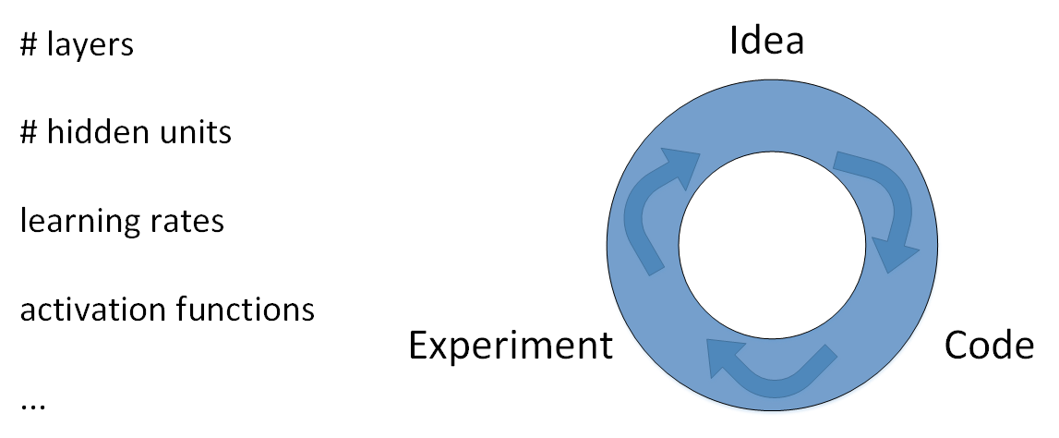
Deep Learning Projects: Hyperparameters
What are Hyperparameters?
In statistics, hyperparameter is a parameter from a prior distribution; it captures the prior belief before data is observed
These parameters need to be initialized before training a model
Its impossible to get all hyperparameters right on a new application from the first time
The idea is to go through the loop: Idea -- > Code --> Experiment
We have to go through the loop many times to figure out the hyperparameters

Slide 3
Deep Learning project: Data Split
Data will be split into three parts
Training set (Has to be the largest set)
Hold-out cross validation set / Development or "dev" set
Testing set
We build models using the training set then try to optimize hyperparameters on dev set as much as possible. After the model is ready we try and evaluate it on the testing set

Slide 4
Deep Learning Project: More on Data Split
What is the ratio of splitting the models?
If size of the dataset is 100 to 1 Million: 60/20/20
If size of the dataset is 1 Million to Inf: 98/1/1 or 99.5/0.25/0.25
Current practices takes most of the data for the training
Also make sure the dev and test set are coming from the same distribution
If cat training pictures is from the web and the dev/test pictures are from user's cell phone they will mismatch
It is better to make sure that dev and test set are from the same distribution
The dev set rule is to try them on some of the good models we've created
Its OK to only have a dev set without a testing set
But a lot of people in this case call the dev set the test set
A better terminology is to call it a dev set as its used in the development

Slide 5
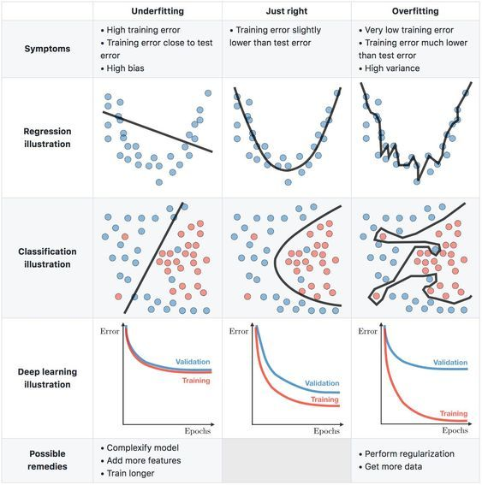
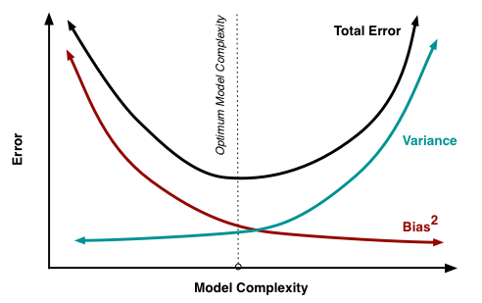
Deep Learning Projects: Bias/Variance
What is Bias/Variance?
If a model is underfitting (logistic regression of nonlinear data) it has a "high bias"
If a model is overfitting, then it has a "high variance"
We need to find a sweet spot in between to balance the Bias/Variance

Slide 6
Bias/Variance how to find balance
High variance (overfitting) example
Training error: 1%
Dev error: 11%
High bias (underfitting) for example
Training error: 15%
Dev error: 14%
High Bias (underfitting) and High variance (overfitting) example
Training error: 15%
Test error: 30%
A balanced example
Training error: 0.5%
Test error: 1%

Slide 7
Recipe for a deep learning project
If your algorithm has a high bias
Try to make your network bigger (size of hidden units, number of layers)
Try a more complex model that is suitable for your data
Try to run it longer
Use more advanced optimization algorithms
If your algorithm has a high variance
Use more data
Try regularization
Try a less complex model that is suitable for your data
You should try the previous two points until you have a low bias and low variance

